Slide 1
Advanced Binary Search
- Srivaths P
Profiles: https://sriv.bio.link/

Slide 2
Implementation
Finds the last index of target
int search(vector<int> a, int target) { int left = 0, right = a.size() - 1; while (left < right) { int mid = (left + right + 1) / 2;
if (a[mid] <= target) left = mid; if (a[mid] > target) right = mid - 1; } return (a[left] == target) ? left : -1; }

Slide 3
Implementation
Finds the first index of target
int search(vector<int> a, int target) { int left = 0, right = a.size() - 1; while (left < right) { int mid = (left + right) / 2;
if (a[mid] < target) left = mid + 1; if (a[mid] >= target) right = mid; } return (a[left] == target) ? left : -1; }

Slide 4
Binary Search points
= should be on the side which we should get rid of if a[mid] is = to target
= side will be unchanging, and other will be changing
Floor (left) or Ceil (right): Should lean towards the "changing" (var != mid) side
just decide where to put ‘=’ --> with ‘>’ or ‘<’ to get all above 3 points done automatically

Slide 5
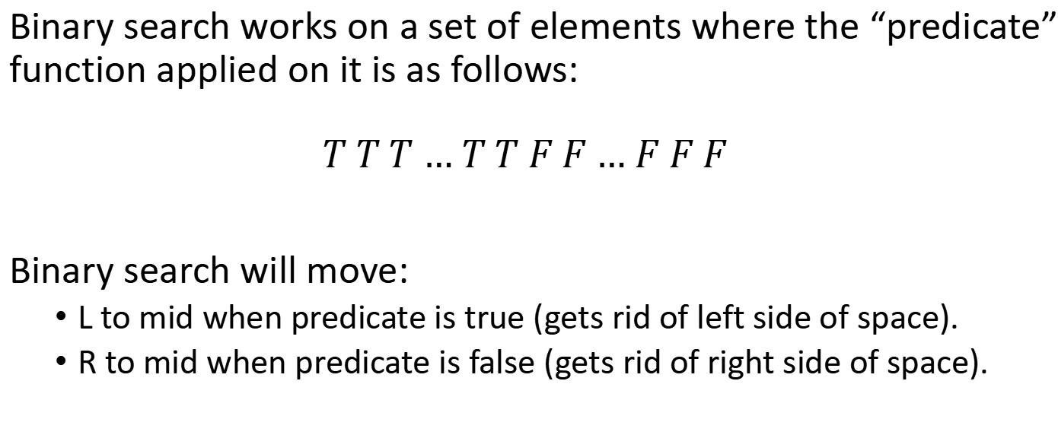
Binary Search Conditions
Binary search works on a set of elements where the “predicate” function applied on it is as follows:
$$T T T … T T F F … F F F$$
Binary search will move:
L to mid when predicate is true (gets rid of left side of space).
R to mid when predicate is false (gets rid of right side of space).

Slide 6
Alternative Binary Search
int l = min-1, r = max+1; while (r-l > 1) { int m = (l + r) / 2; predicate(m) ? (l = m) : (r = m); } // l is the last true // r is the first false
this method considers ‘L’ to be true and ‘R’ to be false initially.
always make predicate( ) such that answer is always either the last’ True’ or the first ‘False’.
L -> last true AND R -> first false, after the binary search. It depends on us what to use L or R for answer.
‘=’ in predicate function tells where our answer lies, if ‘=’ in pred( ) supports L, ans is in ‘L’ and vice-versa.

Slide 7
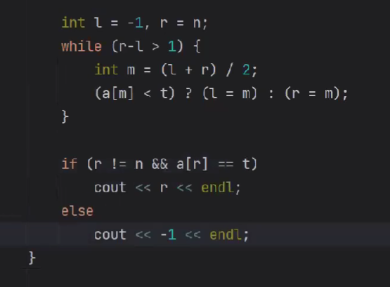
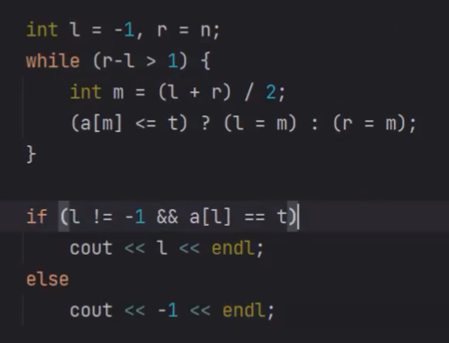
Applications :
First idx of target Last idx of target

Slide 8
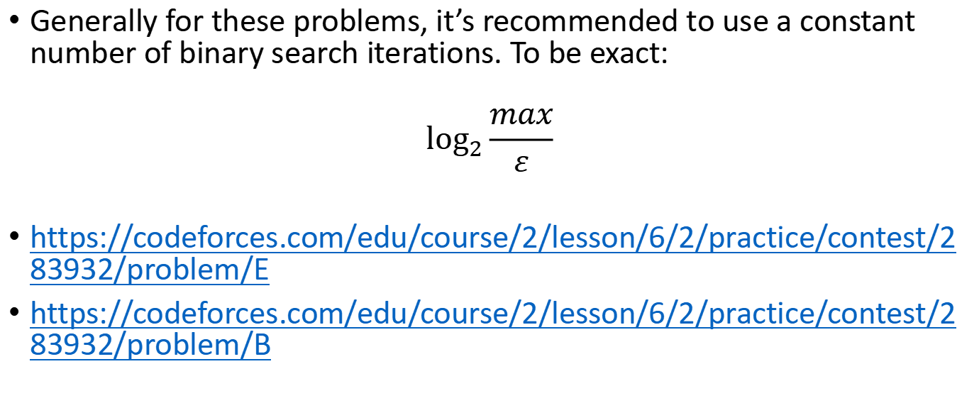
Binary Search on Real Values
Generally for these problems, it’s recommended to use a constant number of binary search iterations. To be exact:
$$\log_{2}{\frac{max}{ε}}$$
https://codeforces.com/edu/course/2/lesson/6/2/practice/contest/283932/problem/E
https://codeforces.com/edu/course/2/lesson/6/2/practice/contest/283932/problem/B

Slide 9
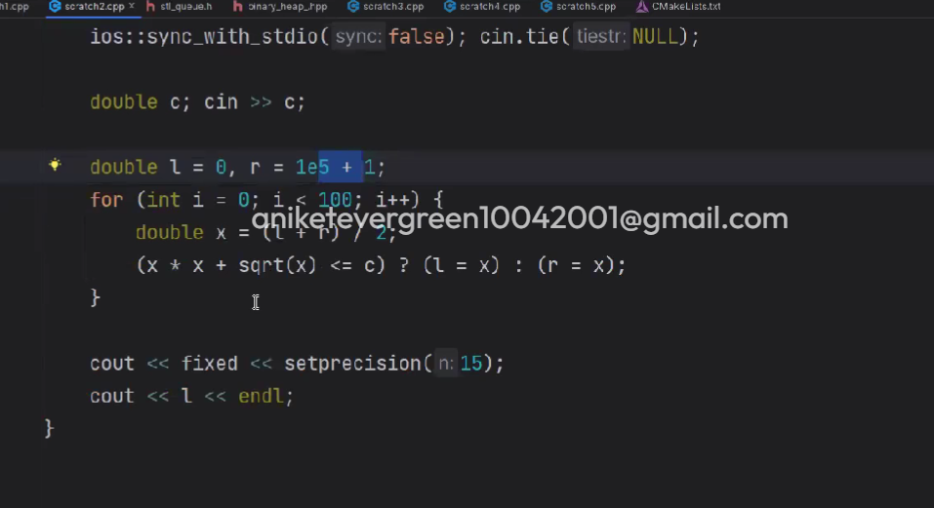
Resources
Example :
Binary Search on real values: https://codeforces.com/blog/entry/63085 https://codeforces.com/edu/course/2/lesson/6/2

Slide 10
Thanks for watching!

